Slide 1
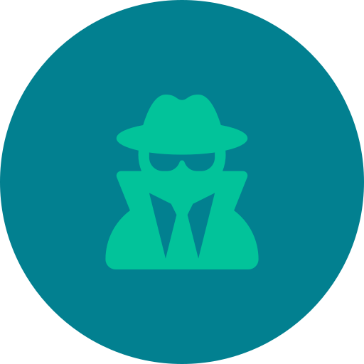
CYBERSECURITY AWARENESS MODULE
Phishing Attacks
How to Recognize, Resist & Report Cyber Threats

Slide 2




OVERVIEW
What Is Phishing?
The Threat Is Real
Phishing is a cyberattack where criminals disguise themselves as trusted sources to steal sensitive data — passwords, credit card numbers, or login credentials.
01
02
03
Deceptive Disguise
Urgency & Manipulation
Data Harvesting
Attackers impersonate banks, tech companies, government agencies, or even colleagues to appear legitimate
Messages create panic or excitement — “Your account will be locked!” — to make victims act without thinking
The goal is to capture credentials, financial data, or install malware on the victim’s device
PHISHING AWARENESS
02

Slide 3





RECOGNITION
Recognizing Phishing Emails
Phishing emails often contain telltale signs. Train yourself to spot them before clicking anything.
Suspicious Sender
Fake Urgency
Email domain is misspelled or mismatched (e.g. support@paypa1.com)
“Act now or lose access!” — pressure tactics to bypass critical thinking
Suspicious Links
Unexpected Attachments
Hover over links — the URL shown doesn’t match the real destination
Unexpected .zip, .exe, or invoice files that install malware when opened
Poor Grammar
Too-Good Offers
Unusual spelling, grammar errors, or awkward phrasing in the message body
Promises of prizes, refunds, or exclusive deals that seem implausible
PHISHING AWARENESS
03

Slide 4





FAKE WEBSITES
Spotting Fake Websites
Don’t Be Fooled by a Polished Look
Fraudulent websites can look nearly identical to real ones. Here’s how to verify you’re on a legitimate site before entering any data.
Check the URL Carefully
Look for subtle misspellings: arnazon.com or paypa1.com. Always confirm the domain name matches the real company exactly.
Verify HTTPS & Certificate
A padlock icon is a good sign, but not a guarantee. Phishers can get SSL certificates too — always verify the full domain, not just the padlock.
Inspect the Page Content
Low-quality images, broken links, missing privacy policies, or generic “Contact Us” pages with no real address are major red flags.
Use a URL Scanner
Tools like Google Safe Browsing or VirusTotal can check whether a URL is known to be malicious before you visit it.
PHISHING AWARENESS
04

Slide 5





SOCIAL ENGINEERING
Social Engineering Tactics
Pretexting
Spear Phishing
Whaling
The attacker fabricates a convincing backstory — posing as IT support, a bank agent, or a delivery service — to extract information or access.
Highly targeted attacks using personal details (your name, job title, coworkers) gathered from LinkedIn or social media to appear credible.
Spear phishing aimed at executives and senior leaders — attackers impersonate CEOs or legal teams to authorize wire transfers or data dumps.
Vishing & Smishing
Baiting
Voice phishing (phone calls) and SMS phishing (text messages) use real-sounding scenarios — “Your card has been charged” — to steal data.
Physical or digital lures — like a found USB drive or a free movie download — that, when used, install malware on the victim’s device.
PHISHING AWARENESS
05

Slide 6

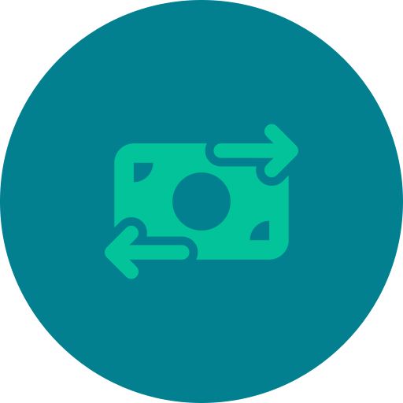

REAL-WORLD EXAMPLES
Phishing in the Wild
These real-world scenarios illustrate how phishing attacks play out across different industries and contexts.
Banking Impersonation
Business Email Compromise (BEC)
Fake Delivery Notifications
Attackers send emails mimicking major banks, warning of “suspicious activity.” Victims click a link to a fake login page and hand over their credentials.
A CFO receives an email appearing to be from the CEO requesting an urgent wire transfer. The attacker spoofed the CEO’s email address to perfection.
A text message claims “your package is on hold — click here to reschedule.” The link leads to a fake courier site harvesting credit card details.
PHISHING AWARENESS
06

Slide 7




BEST PRACTICES
How to Protect Yourself
Your Defense Checklist
Adopting a few consistent habits dramatically reduces your risk of falling victim to a phishing attack.
01
02
Think Before You Click
Enable Multi-Factor Authentication (MFA)
Never click links in unsolicited emails. Go directly to the official website by typing the URL in your browser.
Even if credentials are stolen, MFA adds a second layer that prevents unauthorized access to your accounts.
03
04
Keep Software Updated
Verify & Report Suspicious Messages
Patches fix vulnerabilities that phishing-delivered malware exploits. Enable automatic updates on all devices.
When in doubt, call the sender directly using a known number. Report phishing attempts to your IT team or to reportphishing@apwg.org.
PHISHING AWARENESS
07

Slide 8



INTERACTIVE QUIZ
Spot the Phish — Test Your Knowledge
Read each scenario and decide: Phishing or Legitimate? Think carefully before checking the answer.
Scenario 1
Scenario 2
Scenario 3
You receive an email from support@amaz0n-help.net saying your order is delayed and asking you to verify your payment info via a link.
Your IT department sends a company-wide email from it@yourcompany.com announcing scheduled maintenance this weekend — no links or attachments included.
You get a text message: “URGENT: Your Netflix account is suspended. Update your billing at netflix-secure-update.com immediately.”
PHISHING — The domain “amaz0n-help.net” is not Amazon’s real domain. Legitimate companies never ask for payment info via email links.
LIKELY LEGITIMATE — The sender domain matches your company, no suspicious links are present, and the message requests no sensitive action.
PHISHING — The URL is not netflix.com. Smishing attacks often use look-alike domains with words like “secure” or “update” to seem credible.
PHISHING AWARENESS
08

Slide 9




ACTION PLAN
Your Phishing Defense Roadmap
Put your knowledge into practice with this step-by-step implementation timeline for individuals and teams.
Day 1 — Audit
Week 1 — Train
Month 1 — Harden
Ongoing — Vigilance
Review email filters, enable MFA on all critical accounts, and bookmark official sites you use regularly
Share this module with your team, run a simulated phishing drill, and establish a clear reporting process
Install a reputable anti-phishing browser extension, update all passwords using a password manager, and review app permissions
Subscribe to threat intelligence updates, repeat phishing simulations quarterly, and report every suspicious message
Remember: Cybersecurity is not a one-time task — it’s an ongoing habit. Stay curious, stay skeptical, and when in doubt, verify.
PHISHING AWARENESS
09

Slide 10



Thank You
Stay Safe. Stay Skeptical.
You are now equipped to recognize phishing emails, identify fake websites, understand social engineering tactics, and take action to protect yourself and your organization.
Report Phishing
Stay Updated
Spread Awareness
reportphishing@apwg.org
Follow CISA & NCSC advisories for the latest threat alerts
Share this module with colleagues, friends, and family
When in doubt — don’t click. Verify first.

